Slide 1
Joy!
Revelation 19
Notes:
RUSSIA = EVERWH. → AIRFIELDS NAKED, NO PREP, EVRY SHOT HITS
NO ARAB COORDINATION→ISRAEL 2!
THE JOY 4 ISRAEL

Slide 2
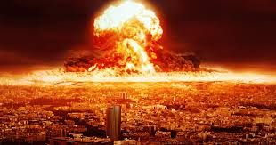
At the Darkest Hour…
Revelation 16:16-20 And the demonic spirits gathered all the rulers and their armies to a place with the Hebrew name Armageddon. …And a mighty shout came from the throne in the Temple, saying, “It is finished!”
Then the thunder crashed and rolled, and lightning flashed. And a great earthquake struck—the worst since people were placed on the earth. …And every island disappeared, and all the mountains were leveled.
Notes:
Demonic: Satan=LOVES 2 KILL Humans
Armageddon=Climax of 3.5 yrs of war
Finished→BAD! **Hard 2 Explain=100 lb bombs, volcano, etc.
**Island..mountains:→Interp. LITERALLY, ~Literalistically

Slide 3
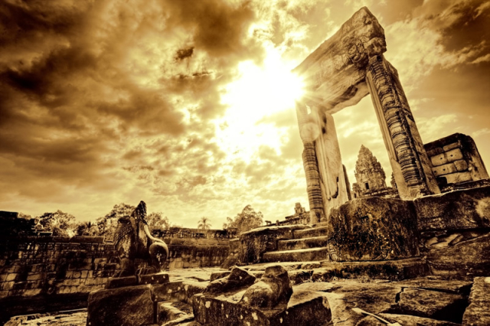
At the Darkest Hour…
Revelation 18:2 He gave a mighty shout: “Babylon is fallen—that great city is fallen!”
Notes:
Babylon→Tower Babel=Ziggarauts=UNITED WRLD
“~End 2 the EVIL…” → G.= Saved Humanity

Slide 4
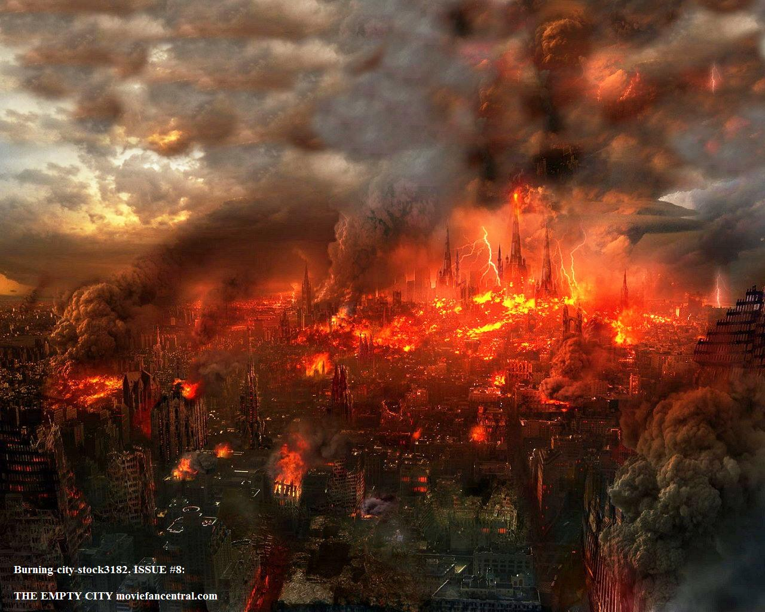
At the Darkest Hour…
Revelation 18:2 …She has become a home for demons. She is a hideout for every foul spirit, a hideout for every foul vulture and every foul and dreadful animal!”
Ephesians 2:2 …you formerly walked according to the course of this world, according to the prince of the power of the air, of the spirit that is now working in the sons of disobedience.
Notes:
“She”→ Epitome of HUMANITY UNITED=Under Satan
Demons→Satan & HORDES=DESTROYS/Vampires
Animal→Rats, cockroaches, wild dogs, scavengers
** = “Course…world” =GRAVITY → AP: Nd. Re-EDUCAT.

Slide 5
Where’s the Peace?
Bush ‘88
“Gentler, Kinder Nation”
Desert Storm
Invasion of Panama
Notes:
→ Is it REALLY GENTLER?? What does “MEAN” look like??

Slide 6
Where’s the Peace?
Obama ‘09
Cairo Speech
Drone Wars
Afghanistan
Muslim View
Longest War in US History
“I've come here to Cairo to seek a new beginning between the United States and Muslims around the world, one based on mutual interest and mutual respect…”
Notes:
Obama ’09→Nobel Peace Price→RESET→Lied? NO!!
**Drone Wars→Civilian Casualties→USA=HATED!!
**Afghanistan→LONGEST War? HOW POSSIBLE?
→There’s a “god of this WORLD” at work
We WILL end up in ARMAGEDDON

Slide 7
At the Darkest Hour…
Sounds Like…
Black Friday
Revelation 18:2 …She has become a home for demons. She is a hideout for every foul spirit…
Revelation 18:11-17 great quantities of gold, silver, jewels, and pearls; fine linen, purple, silk, and scarlet cloth; …fragrant thyine wood, ivory goods, and objects made of other costly wood; and bronze, iron, and marble…cinnamon, spice, incense, myrrh, frankincense, wine, olive oil, fine flour, wheat, cattle, sheep, horses, chariots, and bodies—that is, human slaves
Notes:
Go BACK 2 the Bible 2 Understand…
**Rev.18→the PROBLEM=SLAVES=Currency of W.S.
**Walmart→ Sounds Like OR: **Black Friday

Slide 8
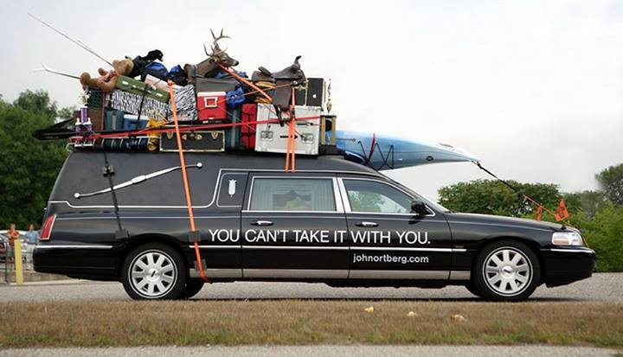
At the Darkest Hour…
Revelation 18:11-17 The merchants of the world will weep and mourn for her… “The beautiful things we loved so much are gone,” they cry. “All the luxuries and splendor are gone forever…”
The merchants who became wealthy by selling her these things will stand at a distance, terrified by her great torment. They will weep and cry out, “How terrible, how terrible for that great city! She was clothed in finest purple and scarlet linens, decked out with gold and precious stones and pearls! In a single moment all the wealth of the city is gone!”
Notes:
THE PROBLEM = Rev.18:11ff → When it’s GONE
** ~Take w/ U → ~Need Rev. 18 to see that
GOSP: =Ur Position 2Day → Meaningless
=Lose Relat/WORK/Direction!

Slide 9
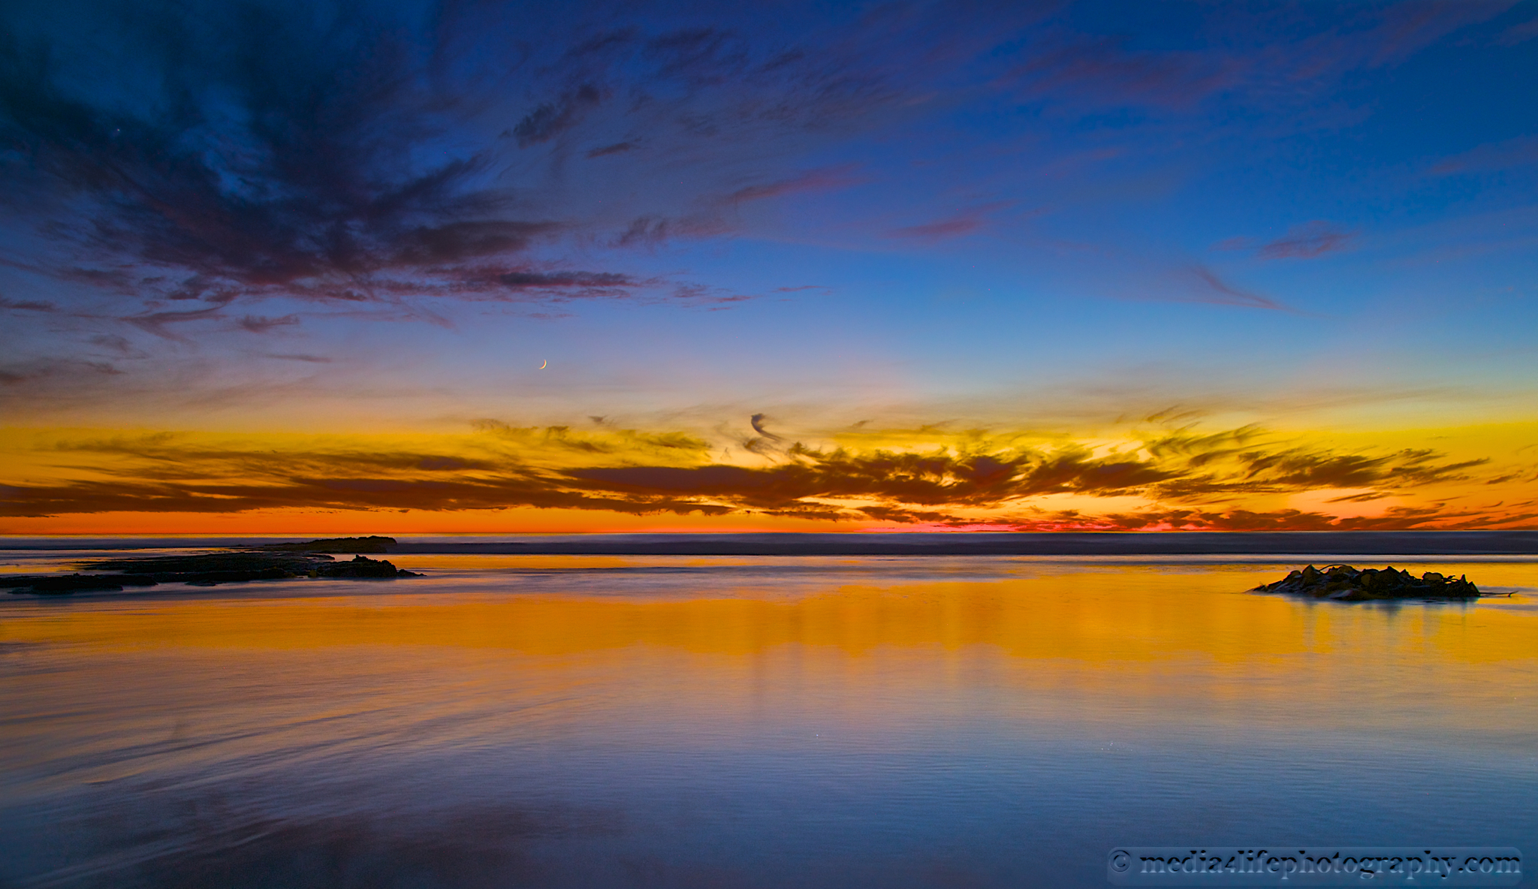
At the Darkest Hour the Greatest Joy!
Revelation 19:1-3 After these things I heard something like a loud voice of a great multitude in heaven, saying, "Hallelujah! Salvation and glory and power belong to our God; because his judgments are true and righteous; for He has judged the great harlot who was corrupting the earth with her immorality, and he has avenged the blood of his bond-servants on her." And a second time they said, "Hallelujah! her smoke rises up forever and ever."
Notes:
The W.S. MOURNS & REPULSED by G’s judgement,
BUT → Angels & Those Underst. History & Time REJOICE!

Slide 10
At the Darkest Hour the Greatest Joy!
Revelation 19:6 Then I heard something like the voice of a great multitude and like the sound of many waters and like the sound of mighty peals of thunder, saying, "Hallelujah! For the Lord our God, the Almighty, reigns.
Notes:
SOMETHING BIG is about to UNFOLD HERE!!

Slide 11
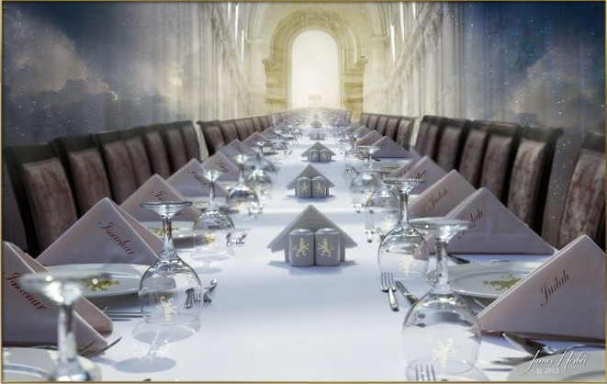
At the Darkest Hour the Greatest Joy!
1 Corinthians 11:26 For as often as you eat this bread and drink the cup, you proclaim the Lord's death until He comes.
Luke 22:18 “for I say to you, I will not drink of the fruit of the vine from now on until the kingdom of God comes.”
Revelation 19:7-9 Let us be glad and rejoice, let us give honor to him. For the time has come for the wedding feast of the Lamb, and his bride has prepared herself. She has been given the finest of pure white linen to wear.” For the fine linen represents the good deeds of God’s holy people. And the angel said to me, “Write this: Blessed are those who are invited to the wedding feast of the Lamb.” And he added, “These are true words that come from God.”
Notes:
The Wedding Feast → 4 Believers & G’s People
** Lk. 22 FINEST WINE!! → “GOOD TIMES” → JOY!!
** 1Cor. → Communion = CELEBRATE in Advance!!

Slide 12
At the Darkest Hour the Greatest Joy!
1 Corinthians 3:13-15 each man's work will become evident; for the day will show it because it is to be revealed with fire, and the fire itself will test the quality of each man's work. If any man's work which he has built on it remains, he will receive a reward. If any man's work is burned up, he will suffer loss; but he himself will be saved, yet so as through fire.
2 Corinthians 5:9-10 Therefore we also have as our ambition, whether at home or absent, to be pleasing to Him. For we must all appear before the judgment seat of Christ, so that each one may be recompensed for his deeds in the body, according to what he has done, whether good or bad.
Revelation 16:15 ”I am coming like a thief. Blessed is the one who stays awake and keeps his clothes, so that he will not walk about naked and men will not see his shame.”
Revelation 19:7-9 ”…his bride has prepared herself. She has been given the finest of pure white linen to wear. For the fine linen represents the good deeds of God’s holy people.”
Notes:
?? Is “white linen” About ?? → ** The RAPTURE→ “~B Naked!”
** Judgment Seat of JC → Good/Bad= “Pleasing 2 Him”
Man-Pleasers, Self-Indulgent=Confused!!
**LOSS=NAKED, ~Lose Salvation

Slide 13
At the Darkest Hour the Greatest Joy!
Keith
Sean
1 Timothy 1:5 But the goal of our instruction is love from a pure heart and a good conscience and a sincere faith.
Notes:
1Ti.1:5=What Matters → “Love” = 4 G & G’s Children
“Heart” → “Make in me a pure heart,” David says → U ~Control It
“Conscience” → Deeds ~Matter IF Man-Pleasing **Sean **KMcC
Man-Pleasing=ONLY if PRESSURED
“Faith” → ??U Trust?? Urself ^ G? → “Sincere” != PRETENSE=Hypocrisy
“Whispered..corners..shouted..rooftops..” → TRUST in REAL GOD ~Misplaced

Slide 14
“I am coming like a thief.”
The King gives orders
Dead bodies reassemble
Living saints caught up
Enter “God’s Estate” together
A great reunion
harpazō – a verb found in thirteen places meaning "take by force" in various settings…forcibly to seize upon, snatch away, caught up, carried away…
1 Thessalonians 4:16-17 For the Lord Himself will descend from heaven with a shout, with the voice of the archangel and with the trumpet of God,
and the dead in Christ will rise first.
Then we who are alive and remain will be caught up
together with them in the clouds to meet the Lord in the air,
and so we shall always be with the Lord.
Notes:
What ALREADY OCCURRED in Rev. = “Great Catch”
1Thes=DETAILS→ 4BELIEVRS → ~UNFAIR →GOSP:

Slide 15
AFTER The “Great Catch”
Indians World Series
Wrigley Field
1 Thessalonians 5:9-11 For God has not destined us for wrath, but for obtaining salvation through our Lord Jesus Christ, who died for us, so that whether we are awake or asleep, we will live together with Him.
Therefore encourage one another and build up one another, just as you also are doing.
Notes:
AFTER=Chaos of Mystery Babylon → **INDIANS ** CUBS
**1Th.5=Rsn. 4 “Coming…thief” → 2 SAVE US!! →2b Together!!
** THEREFORE: ENCOURAGE = Simple Enough!! →
AP: Many Need It Here, ESP. thru Dark Times

Slide 16
Rev. 16:15 ”I am coming like a thief. Blessed is the one who stays awake and keeps his clothes…”
Israel regathered in Israel
God’s “Restraint” is removed
Israel flourishes, enemies decay
Great “church” denial of JC
End of the “Church Age” 1967
1 Thessalonians 5:3-8 While they are saying, "Peace and safety!" then destruction will come upon them suddenly like labor pains upon a woman with child, and they will not escape. But you, brethren, are not in darkness, that the day would overtake you like a thief; for you are all sons of light and sons of day.
Global media
Global leader
Global religion
European 10-nation union
Global, non-currency economy
Global unity
Humans destroying the planet
HUGE armies gathering
W.M.D. unleashed
Russia as a World Power
“China” World Power
Iranian-led alliance of Israel’s neighbors
Notes:
** “Peace..safety” = “TRUMP, at last!” ^ “Hillary Saved Us!”
~B APATHETIC=XIANS 2Day
AP: ~b Confused re: Allegiance/Safety → DO VOTE!

Slide 18
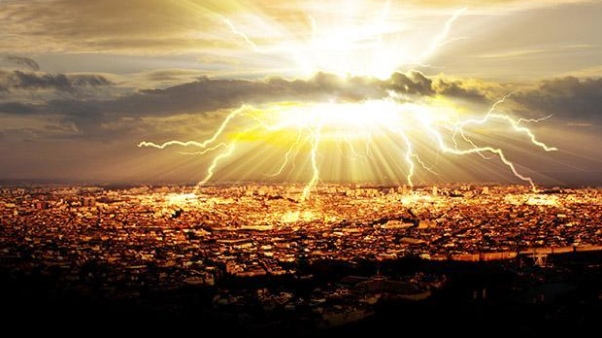
The “Second Coming” of the King
Revelation 19:11-13 And I saw heaven opened, and behold, a white horse, and He who sat on it is called Faithful and True, and in righteousness He judges and wages war. His eyes are a flame of fire, and on His head are many diadems; and He has a name written on Him which no one knows except Himself. He is clothed with a robe dipped in blood, and His name is called The Word of God.
Notes:
Then…

Slide 19
The “Second Coming” of the King
“By rightness he wages war”
“From his mouth…a sharp sword”
“Will rule…with a rod of iron…”
Revelation 19:14-16 And the armies which are in heaven, clothed in fine linen, white and clean, were following Him on white horses. From His mouth comes a sharp sword, so that with it He may strike down the nations, and He will rule them with a rod of iron; and He treads the wine press of the fierce wrath of God, the Almighty. And on His robe and on His thigh He has a name written, "KING OF KINGS, AND LORD OF LORDS."

